Slide 1
Introducing SMT/Z3
Nikolaj Bjørner, Microsoft Research, RiSE
November 6, 2025
A Guido Martínez guest lecture production

Slide 2
Why SMT?
Claim: Every program analysis, test and verification scenario involves at a core solving symbolic formulas
SMT supports formalisms suitable for program analysis
SMT solver technologies tune for SAT and UNSAT equally.

Slide 3
Material
z3 source on GitHub https://github.com/z3prover/z3
Online guide https://microsoft.github.io/z3guide
Tutorial document https://z3prover.github.io/papers/z3internals.html
Guest lectures x 10 https://z3prover.github.io/slides/guest-lectures-wien-2025

Slide 4

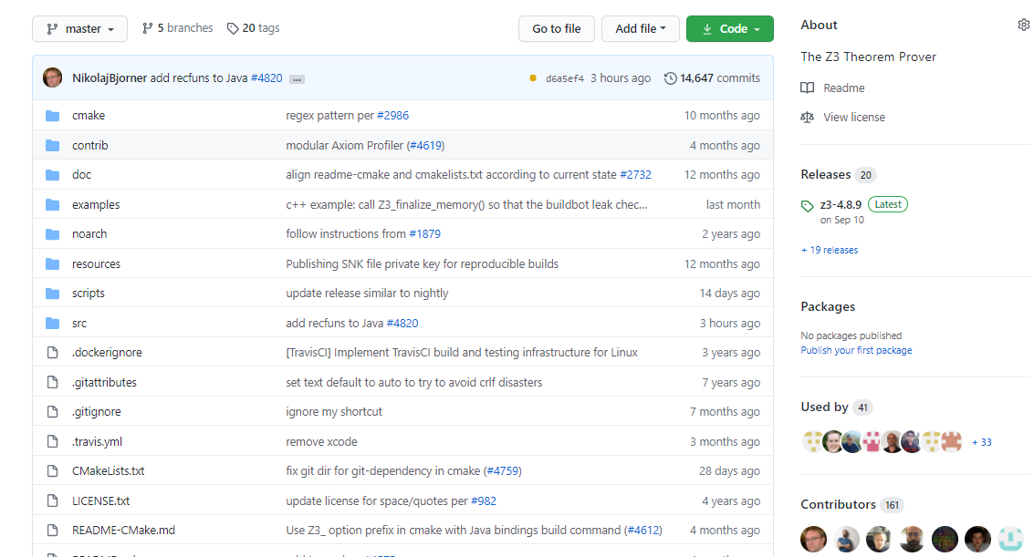
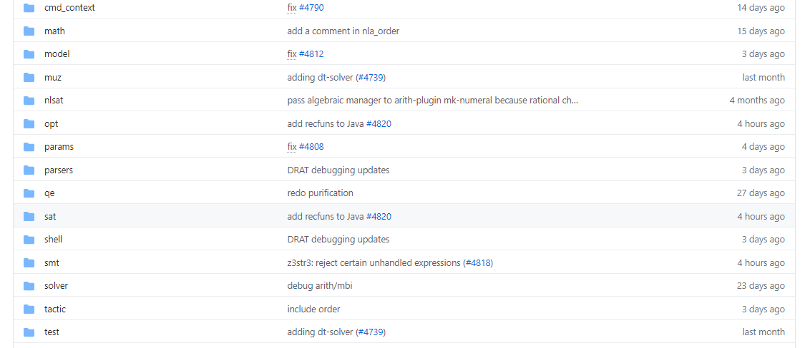
on GitHub
Source code

Slide 5
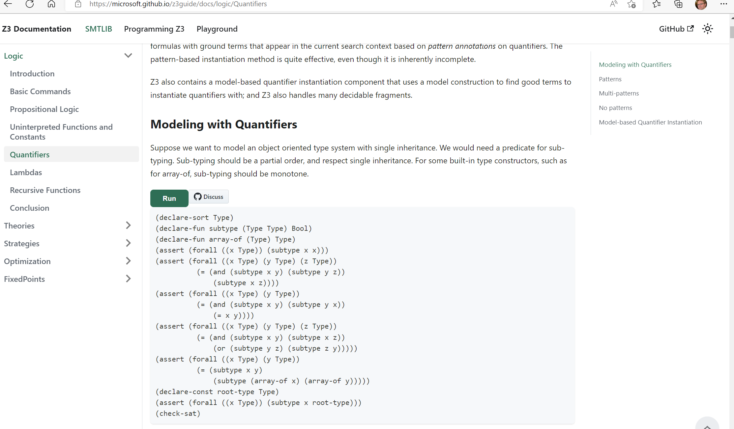
Online guide

Slide 6
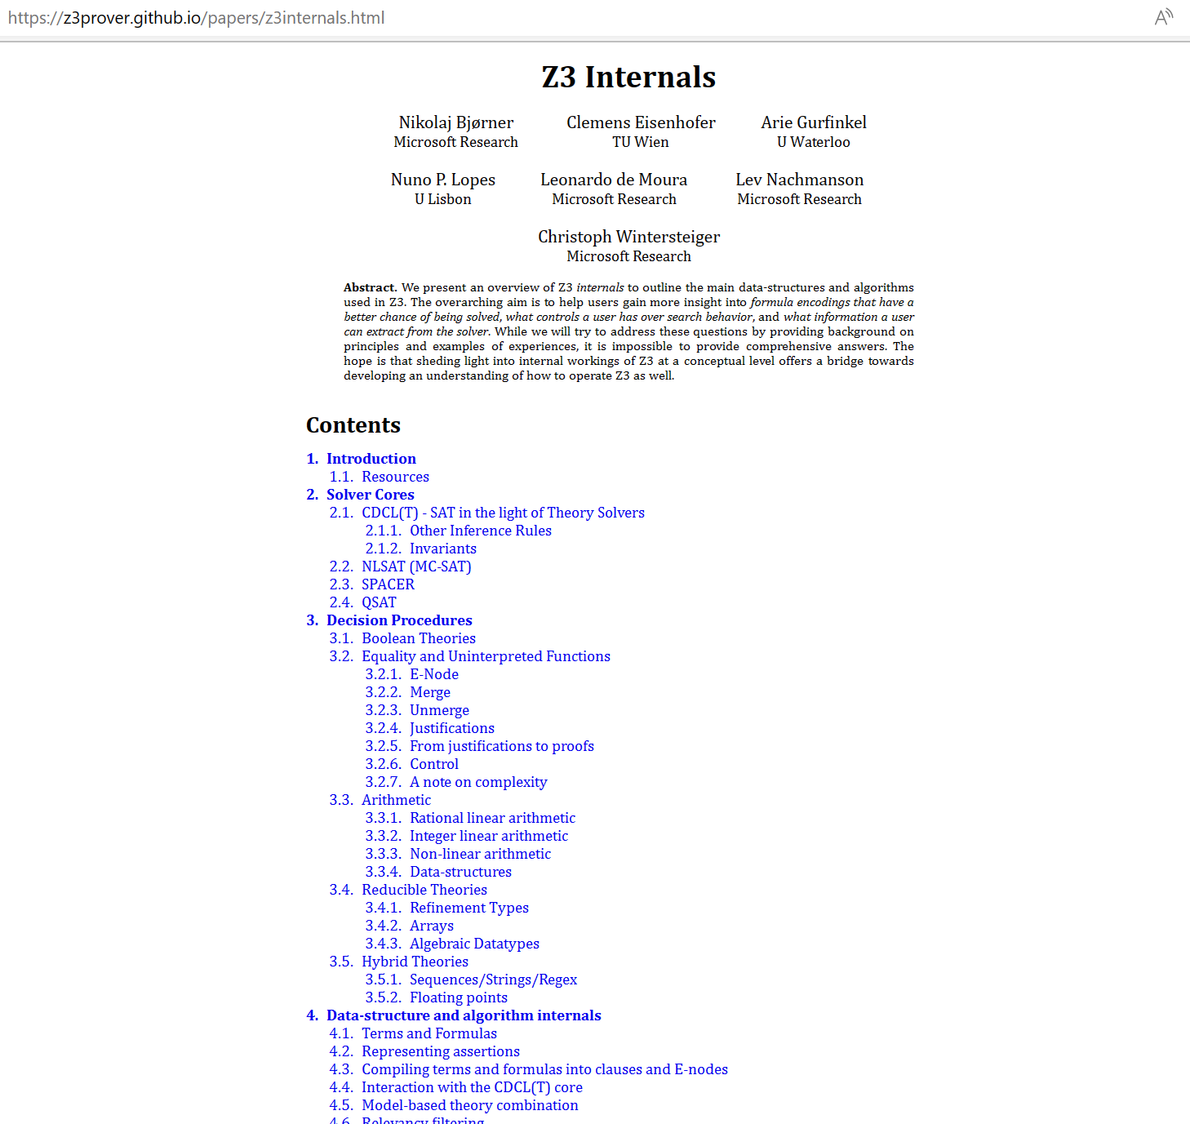

Slide 7
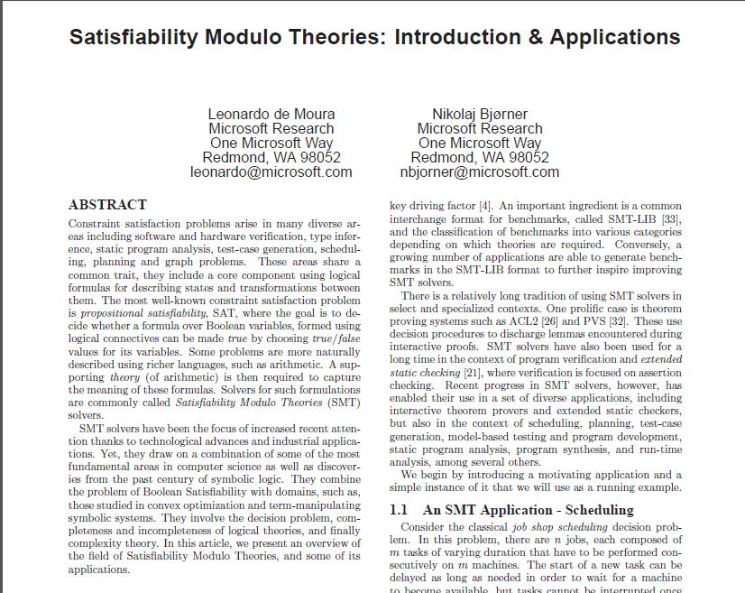

Background Reading: SMT
September 2011

Slide 8
SAT in a nutshell

Slide 9
SAT in a nutshell
(Tie ∨ Shirt) ∧ ( ¬Tie ∨ ¬Shirt) ∧ (¬Tie ∨ Shirt)

Slide 10
SMT in a nutshell

Slide 11
Satisfiability Modulo Theories (SMT)
Is formula ϕ satisfiable modulo theory T ?
SMT solvers have specialized algorithms for T

Slide 12
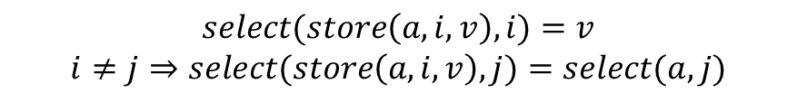
Satisfiability Modulo Theories (SMT)
$$x+2=y⇒f\left(select\left(store\left(a,x,3\right),y−2\right)\right)=f(y−x+1)$$
Array Theory
Arithmetic
Uninterpreted Functions
$$select(store\left(a,i,v\right),i)=v$$
$$i≠j⇒select(store\left(a,i,v\right),j)=select(a,j)$$

Slide 13
SMT Solving in a nutshell
Job Shop Scheduling

Slide 14






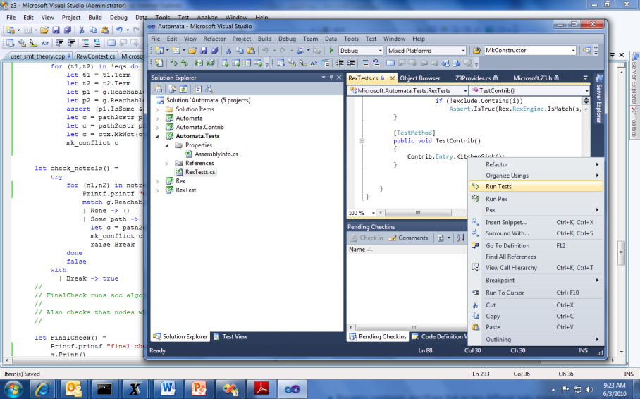


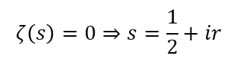
Job Shop Scheduling
Machines
Tasks
Jobs
P = NP?
Laundry
$$ζ\left(s\right)=0⇒s=\frac{1}{2}+ir$$

Slide 15

Job Shop Scheduling
Constraints:
Precedence: between two tasks of the same job
Resource: Machines execute at most one job at a time
3
1
2
4
$$\left[start_{2,2}..end_{2,2}\right]∩\left[start_{4,2}..end_{4,2}\right]=∅$$

Slide 16
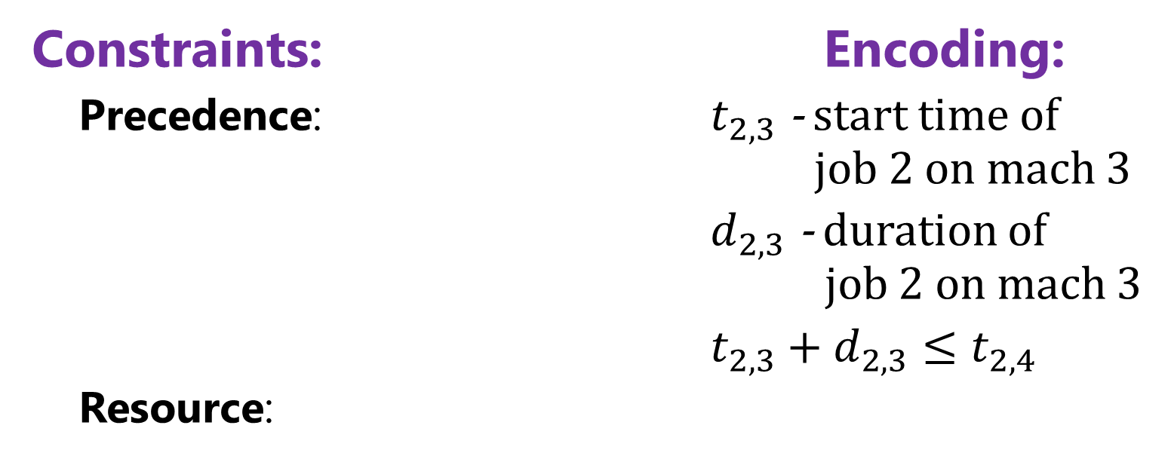
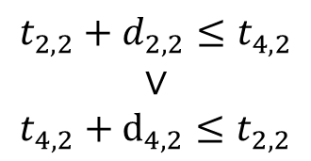
Job Shop Scheduling
Constraints: Encoding:
Precedence: $t_{2,3}$ - start time of job 2 on mach 3
$d_{2,3}$ - duration of job 2 on mach 3
$t_{2,3}+d_{2,3}≤t_{2,4}$
Resource:
3
1
4
2
Not convex
$$t_{2,2}+d_{2,2}≤t_{4,2}$$
$$∨$$
$$t_{4,2}+d_{4,2}≤t_{2,2}$$
$$\left[start_{2,2}..end_{2,2}\right]∩\left[start_{4,2}..end_{4,2}\right]=∅$$

Slide 17
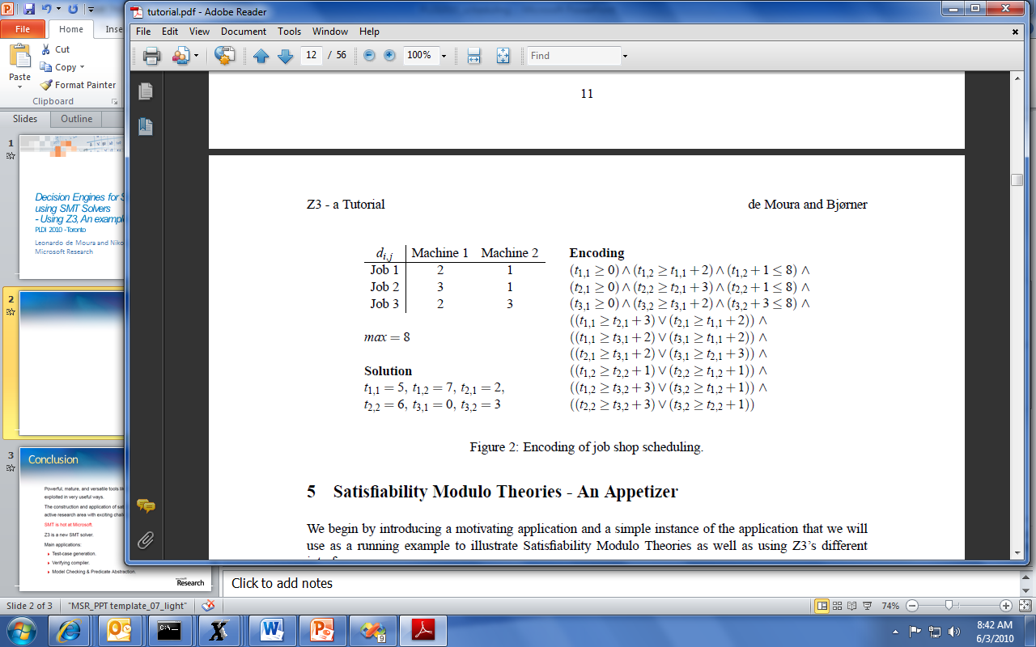
Job Shop Scheduling

Slide 18
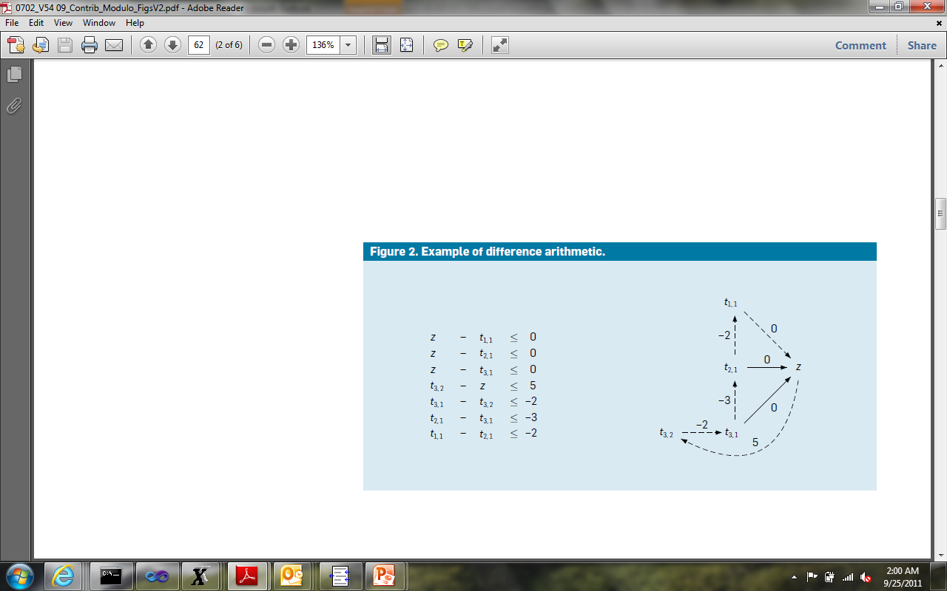
Job Shop Scheduling
Efficient solvers:
- Floyd-Warshal algorithm
- Ford-Fulkerson algorithm
case split
case split
$$z −z= 5 – 2 – 3 – 2 = −2 < 0$$

Slide 19
Big-picture Interfacing with Z3

Slide 20
Efficiency
Scale
Technology Landscape
Propositional
Satisfiability Solving
SAT
Breakthroughs in 2000s
Cheap local Inferences
Garbage collect useless clauses
Hardware Design
Automation
Breakthroughs late 2000s
SAT + global inferences +
global propagators
Mixed Integer
Programming
MIP
Breakthroughs in 1960s
Harnessed since 1990s
LP: global Inferences
IP: Cuts, Branch and Bound
Satisfiability Modulo Theories
Operations
Research
CP-SAT
SMT
Z3
Constraint
Programming
Software Development +…
CP
Breakthroughs since 1990s
Powerful domain-tailored
global propagators
Expressive Power

Slide 21
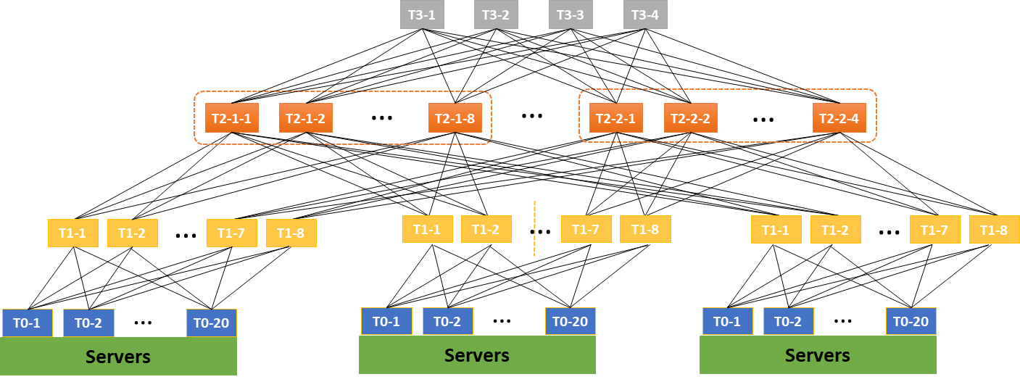


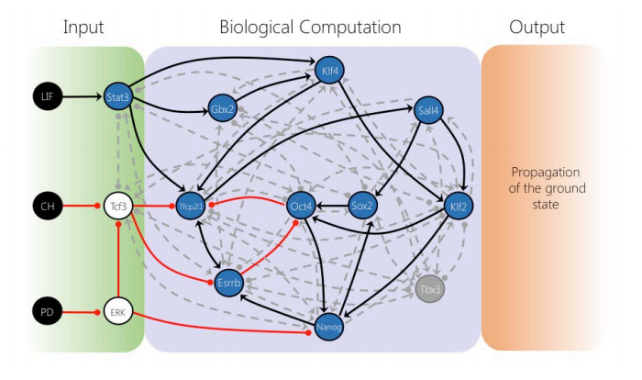



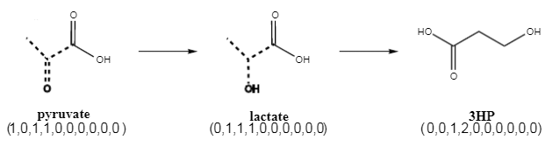



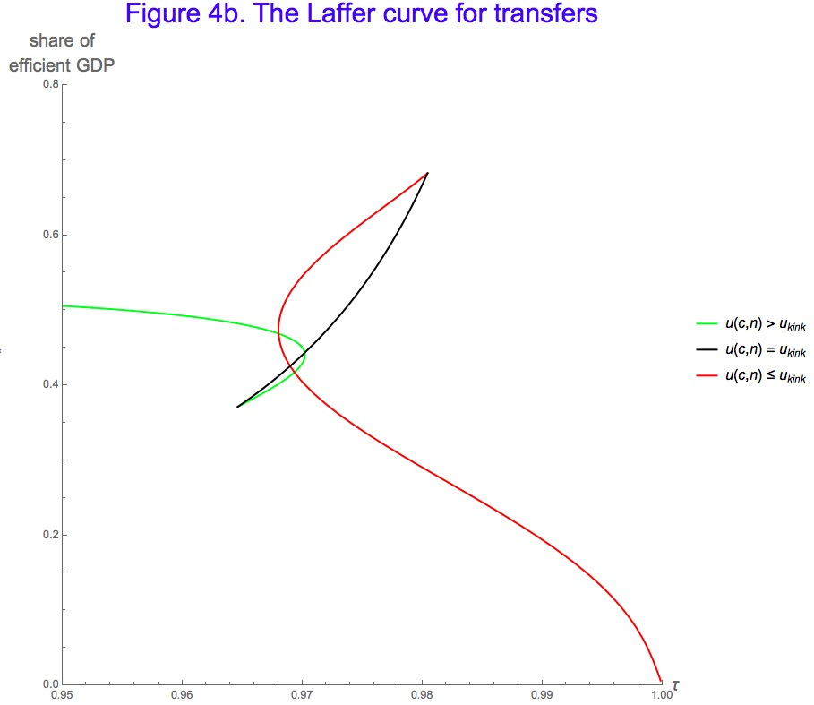


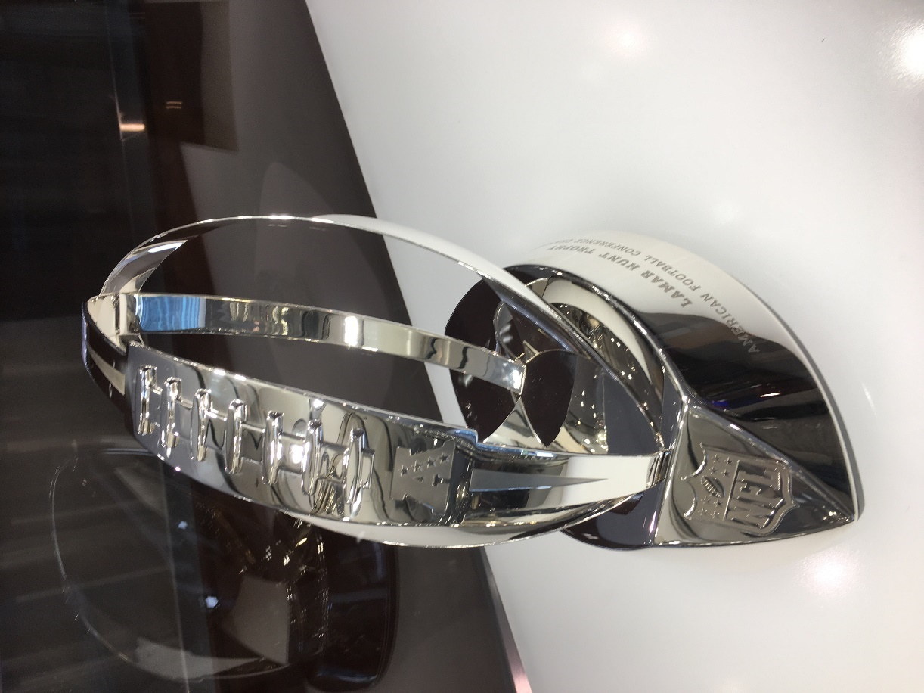
for Software +…
Azure Network
Verification
Verifying C
Compiler
Quantum
Compilation
Biological
Computations
Verified Crypto
Libraries & Protocols
Dynamics
AX
SVACE
Static Analysis Engines
Artificial
Life
Security Risk Detection
Smart Contract
Verification
ALIVE2
Translation Validation
for LLVM & Visual C++
Axiomatic
Economics
NFL
Scheduling

Slide 22

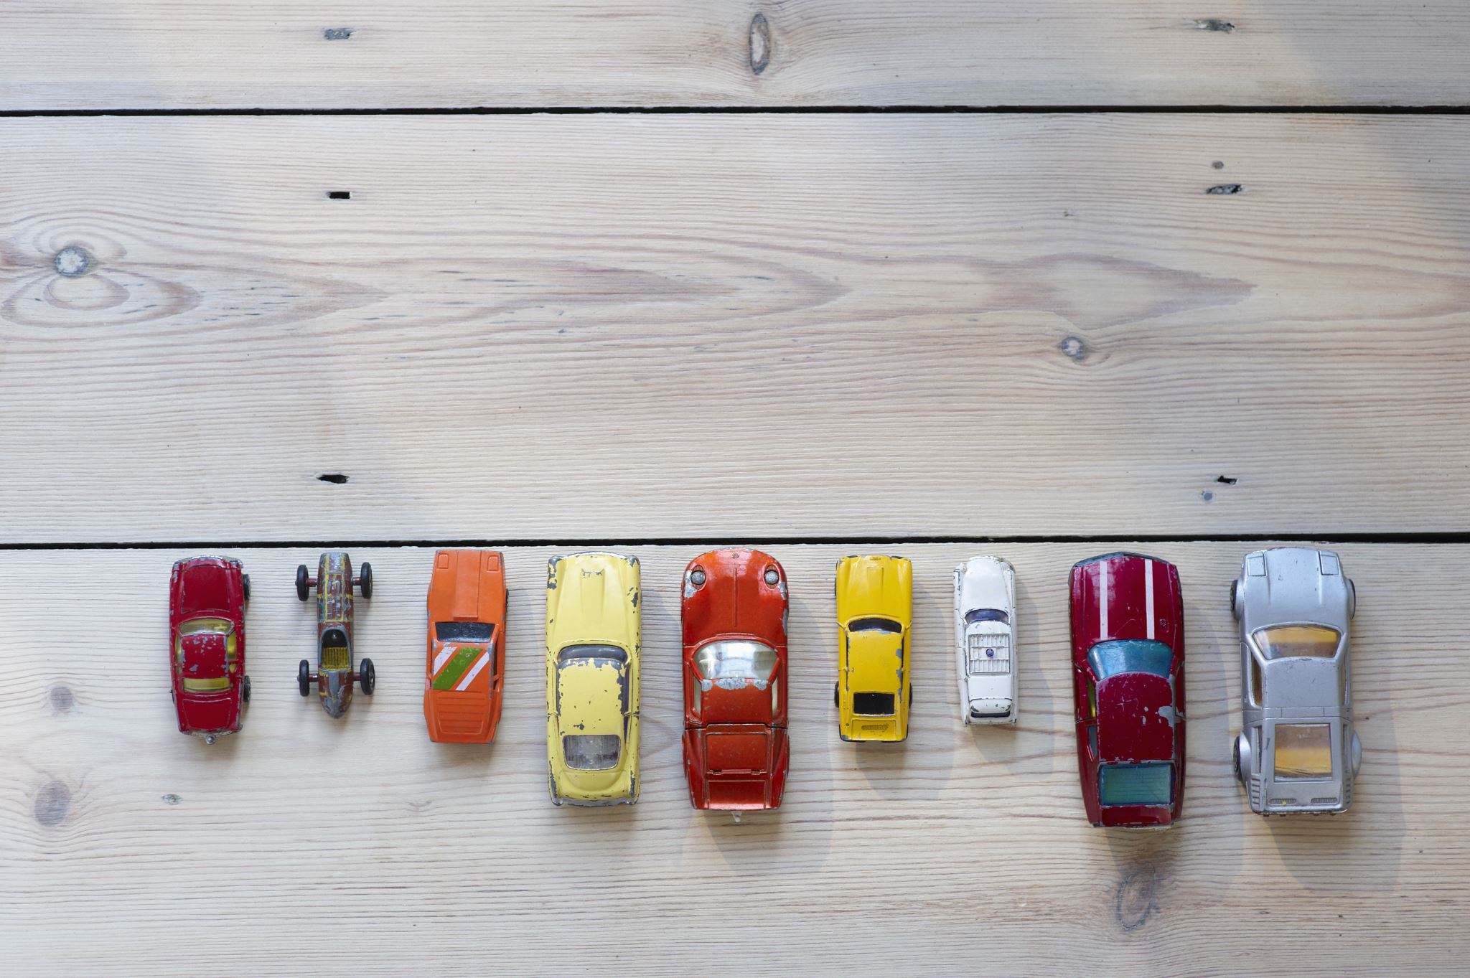


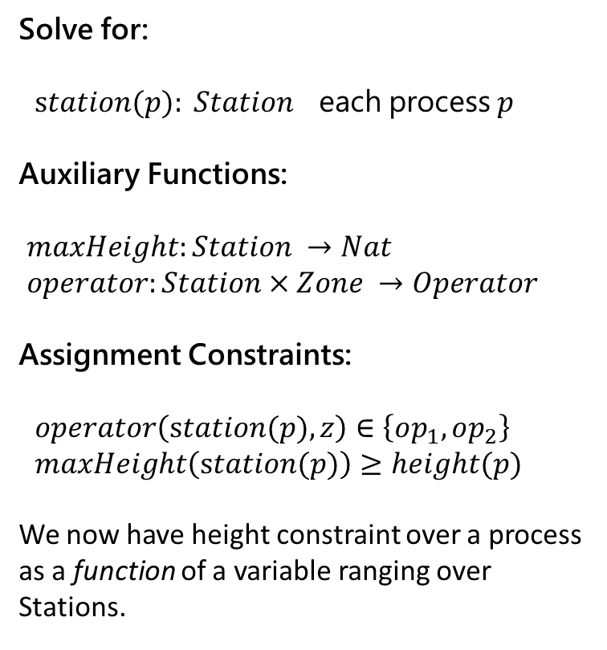
Encoding – A case study
Solve for:
$station(p): Station$ each process $p$
Auxiliary Functions:
$maxHeight:Station →Nat$
$operator:Station×Zone →Operator$
Assignment Constraints:
$operator\left(station(p),z\right)∈\left\{op_{1},op_{2}\right\}$
$maxHeight\left(station(p)\right)≥height(p)$
We now have height constraint over a process as a function of a variable ranging over Stations.
Process
Task 1
Task 2
Task 3
Task 4
Task 5
Task 6
Process
Task 1
Task 2
Task 3
Task 4
Task 5
Task 6
Process
Task 1
Task 2
Task 3
Task 4
Task 5

Slide 23
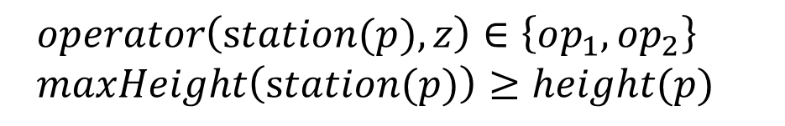
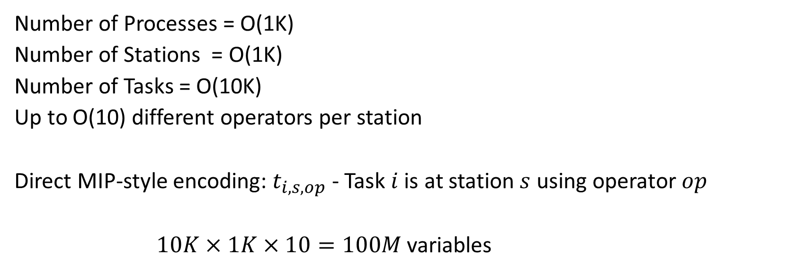
Encoding - Domain Overload
Number of Processes = O(1K)
Number of Stations = O(1K)
Number of Tasks = O(10K)
Up to O(10) different operators per station
Direct MIP-style encoding: $t_{i,s,op}$ - Task $i$ is at station $s$ using operator $op$
$10K×1K×10=100M$ variables
SMT approach: Use uninterpreted functions for “symbolic indices”
$operator\left(station(p),z\right)∈\left\{op_{1},op_{2}\right\}$
$maxHeight\left(station(p)\right)≥height(p)$

Slide 24
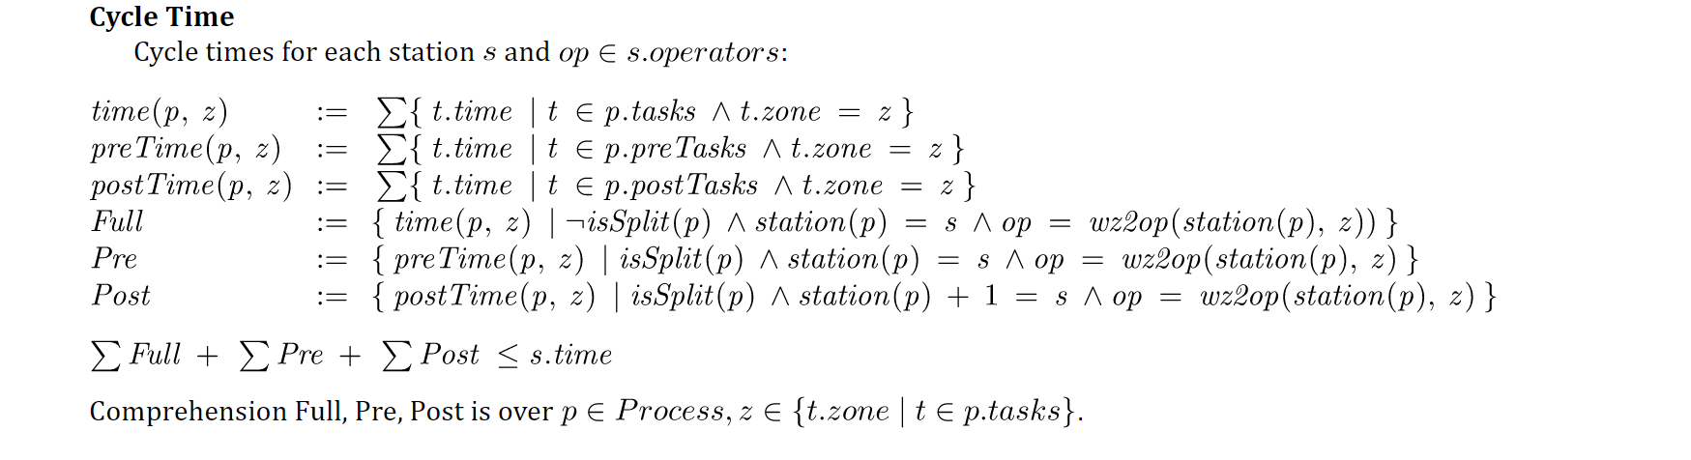
Encoding - Constraint Overload
a polluting, nasty side constraint
Constrained multi-knapsack:
A set of items, each is added to one knapsack, subject to side-constraints
Z3 approach: Programming Custom Theories (no built-in scheduling constraints)

Slide 25
SMT Solving Fundamentals

Slide 26
Satisfiability Modulo Theories (SMT)
Is formula ϕ satisfiable modulo theory T ?
SMT solvers have specialized algorithms for T

Slide 27
CDCL(T)
Theory
Solvers
SMT
SAT
Equality + UF
Arithmetic
Bit-vectors
…
Case Analysis

Slide 28

Elements of Solving
Satisfiability Preserving Pre/in-processing
Search
Encoding and re-encoding
can also be considered an
element of solving loop.

Slide 29
Search Engines
CDCL(T) SPACER NLSAT QSAT

Slide 30
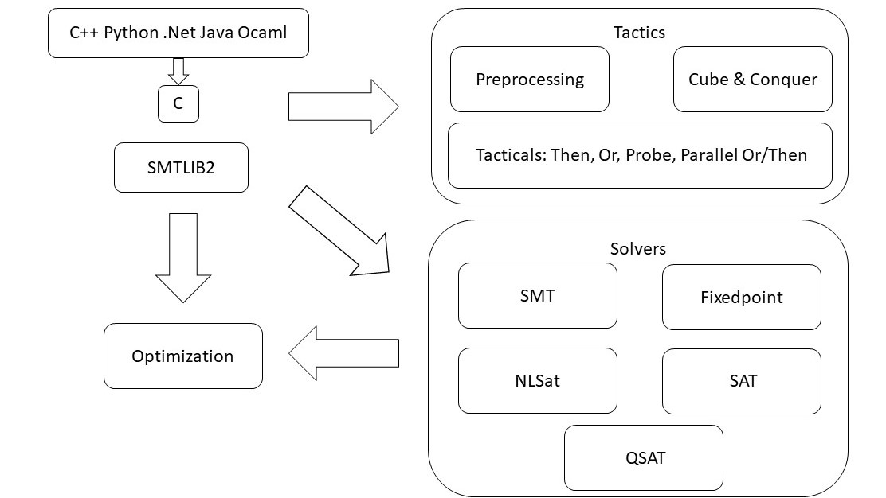
overview

Slide 31
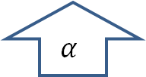
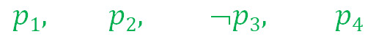

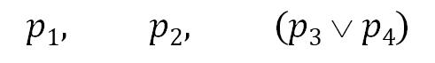

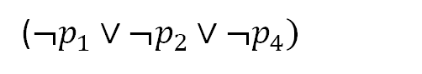
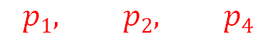
CDCL(T)
x ≥ 0, y = x + 1, (y > 2 ∨ y < 1)
$$α$$
$$p1, p2, (p3  p4)$$
Strengthen
($¬p_{1}∨¬p_{2}∨¬p_{4})$
SAT
Block
$$p1, p2, ➢p3, p4$$
$$p1, p2, p4$$
$$γ$$
$$α$$
Theory Conflict
x ≥ 0, y = x + 1, y ≤ 2, y < 1
x ≥ 0, y = x + 1, y < 1

Slide 32
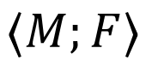
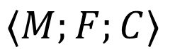
CDCL(T) – Main State Variables
Search State
$$⟨M;F⟩$$
$$⟨M;F;C⟩$$
Conflict State
F – set of clauses
Split into irredundant and redundant clauses.
Redundant clauses can be garbage collected.
2 literal watch list and binary clause optimization
M – a trail of assigned literals
C – a conflict clause

Slide 33
CDCL(T) – Dual Model/Proof search
Backjump
Models
literal assignments
Proofs
Conflict Clauses
Conflict Resolution
Propagate

Slide 34
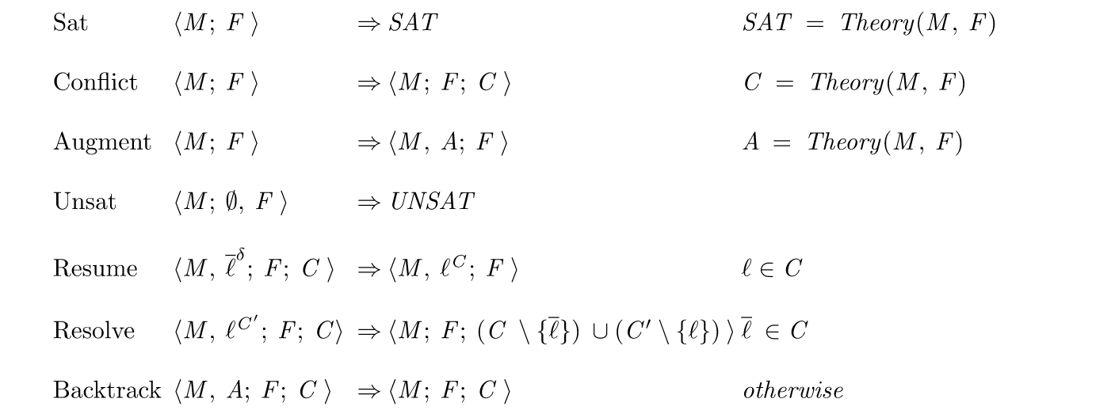
CDCL(T) as inference rules

Slide 35
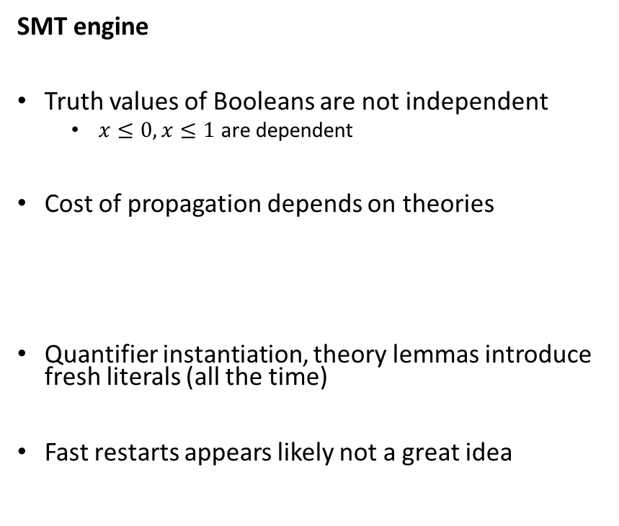
CDCL(T) – SAT vs SMT
SAT engine
Truth assignment is symmetric for Boolean variables
Probing (for failed literals)
L is failed if asserting L & F infers false by unit propagation.
Cost of propagation controlled by clause watch list
Boolean Variables are fixed during search
“Fast restart” introduced to prioritize variables used in conflicts
SMT engine
Truth values of Booleans are not independent
$x≤0, x≤1$ are dependent
Cost of propagation depends on theories
Quantifier instantiation, theory lemmas introduce fresh literals (all the time)
Fast restarts appears likely not a great idea

Slide 36
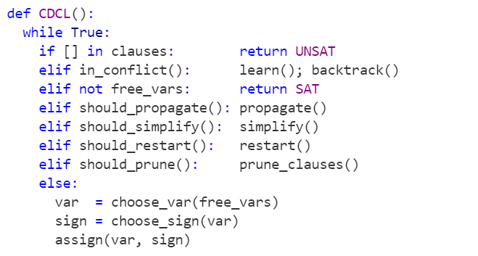
CDCL – CaDiCaL loop

Slide 37
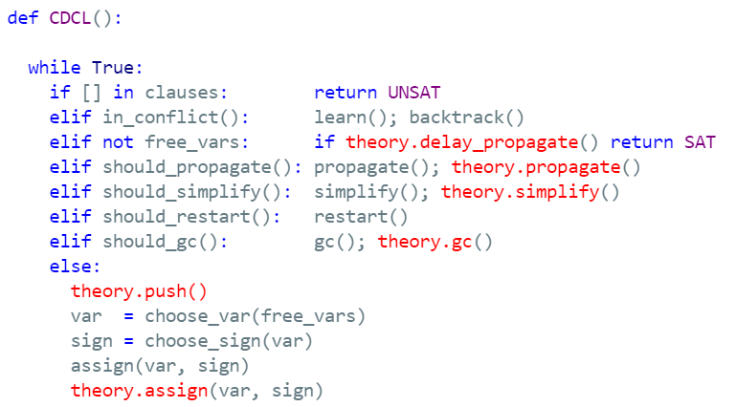
CDCL(T)

Slide 38
Core Decision Procedures
Samples

Slide 39
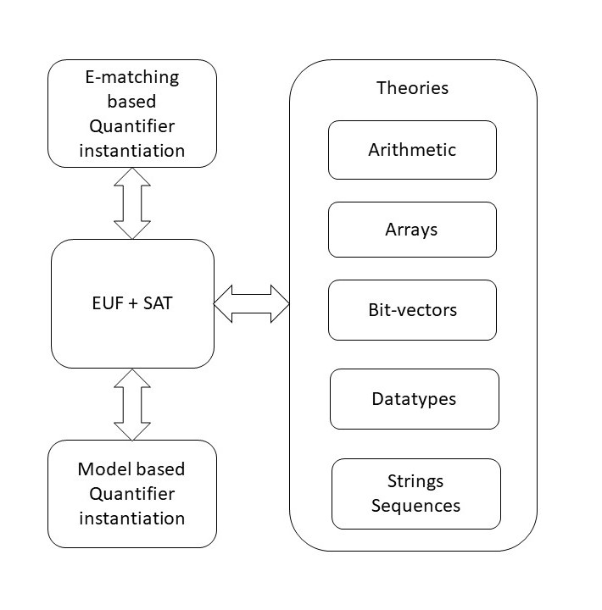
overview

Slide 40
Classification
Arrays
Finite Domains
ADTs
EUF
Arithmetic
Hybrid
str.len, bv2nat
User-Propagator

Slide 41
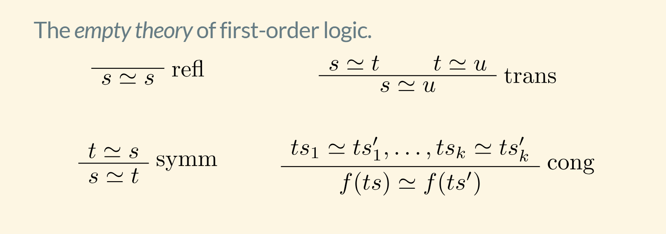
EUF

Slide 42
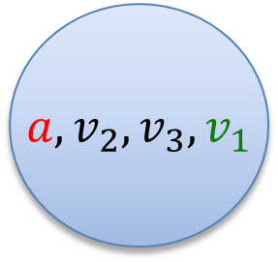
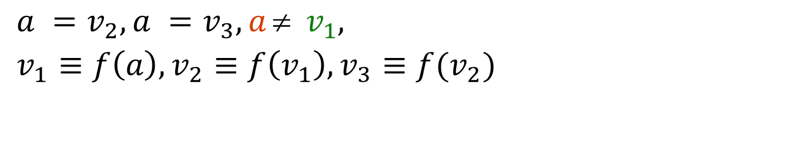
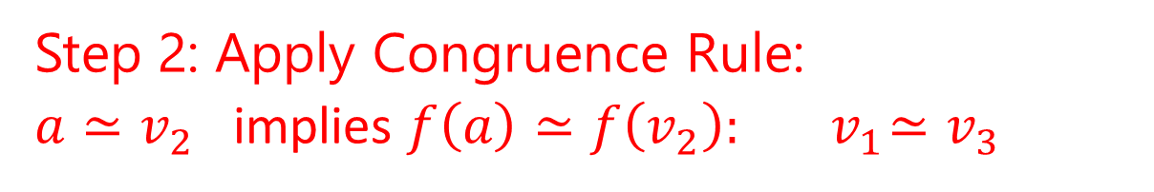
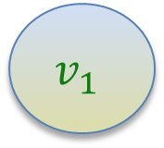
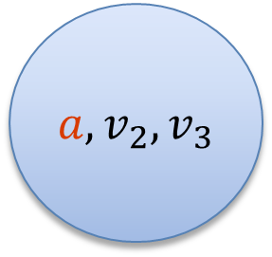
EUF
$$a = f(f(a)), a = f(f(f(a))), a  f(a)$$
Produce Proofs
Incremental Updates
Propagate Literals
$a =v_{2}, a =v_{3}, a  v_{1},$
$v_{1}≡f\left(a\right), v_{2}≡f\left(v_{1}\right), v_{3}≡f(v_{2})$
$a, v_{2}, v_{3}$
$$v_{1}$$
Union Find
Step 1: Equivalence classes from equalities
$a, v_{2}, v_{3}, v_{1}$
Step 2: Apply Congruence Rule:
$a≃v_{2}$ implies $f\left(a\right)≃f\left(v_{2}\right):{ v}_{1}≃v_{3}$
E-graph

Slide 43
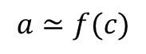
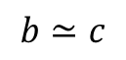
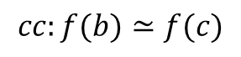
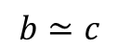
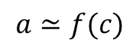
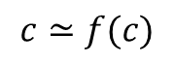
EUF – union-find w. path compression, siblings
Z3 uses path compression to ensure roots are within a single hop of find
Maintain separate singly linked cyclic list of siblings
$$a≃f(c)$$
$$b≃c$$
$$c≃f(c)$$
a
a
b
b
$$b≃c$$
$$a≃f(c)$$
f(b)
f(b)
f(c)
f(c)
c
c
$$cc:f(b)≃f(c)$$

Slide 44
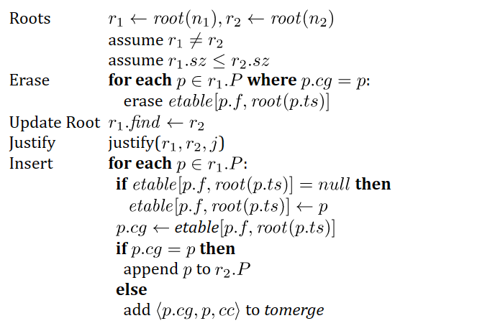
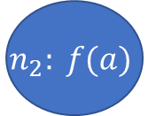
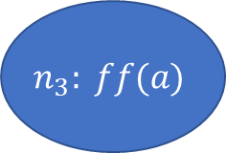









EUF - merge
$$a = f(f(a)), a = f(f(f(a))), a  f(a)$$
$$n_{2}: f(a)$$
$$n_{3}: ff(a)$$
$$n_{4}: fff(a)$$
$$n_{1}:a$$
$${merge(n}_{1},n_{3})$$
$etable\left[f,n_{1}\right]←null$ (since $n_{2}∈n_{1}.P)$
$$n_{1}.find←n_{3}$$
$$n_{2}: f(a)$$
$$n_{3}: ff(a)$$
$$n_{4}: fff(a)$$
$$n_{1}:a$$
($n_{2}∈n_{1}.P)$
$n_{2}.cg←etable[f, {root(n}_{1})]=$ $n_{4}$
$add \left\langle n_{2},n_{4}\right\rangle$ to tomerge

Slide 45









EUF - Justifications
a
b
Union – find link
$$a≃f(c)$$
$$b≃c$$
Justification link
f(b)
f(c)
c
$$cc:f(b)≃f(c)$$
a
After merge
$$c≃f(c)$$
b
$$a≃f(c)$$
$root\left(c\right)←root(f\left(c\right))$
Justification path from
old root(c) to c got reversed
$$b≃c$$
f(b)
f(c)
$$cc:f(b)≃f(c)$$
c
$$c≃f(c)$$

Slide 46


Arrays – reduced to EUF
Compile into EUF
UNSAT

Slide 47


Arrays – reduced to EUF
Convert EUF solution to
solution over arrays
Compile into EUF

Slide 48

A Solver for Unicode Characters
Unicode Theory
$⟨U, ≤,=:U×U→Bool⟩$ $\left|U\right|=196608$
Operator $≤$ is used sparingly
So common case is theory of $=,≠$
Engine: Union-find + Lazy reduction to bit-vectors
Inferior alternatives: pure bit-vectors, linear arithmetic, difference arithmetic

Slide 49

A Solver for $⟨U, ≤,=:U×U→Bool⟩$ $\left|U\right|=196608$
Equality
Union Find
a
b
c
d
e
s
t
a = b, b = c, d = e, b = s, d = t, a≠ e, a≠ s
a,b,c,s
d,e,t

Slide 50
A Solver for $⟨U, ≤,=:U×U→Bool⟩$ $\left|U\right|=196608$
Equality
Union Find
a
b
c
d
‘e’
s
‘t’
a = b, b = c, d = ‘e’, b = s, d = ‘t’, a≠ e
a,b,c,s
d,’e’,’t’

Slide 51




A Solver for $⟨U, ≤,=:U×U→Bool⟩$ $\left|U\right|=196608$
$$a≤b$$
Inequality
Bit-blasting
$\left(a\left[17\right]→b\left[17\right]\right)$
$∧\left(\begin{aligned}(a\left[17\right]↔b\left[17\right])→ \\ a\left[16:0\right]≤b\left[16:0\right]\end{aligned}\right)$
$$a\left[17:0\right]≤b\left[17:0\right]↔$$
$$⋮$$
$$a\left[0:0\right]≤b\left[0:0\right]↔\left(a\left[0\right]→b\left[0\right]\right)$$

Slide 52



A Solver for $⟨U, ≤,=:U×U→Bool⟩$ $\left|U\right|=196608$
Combining two views
$$a=b$$
$$a≤b$$
Equality View
Bit-Blast View
$$⟨U, ≤,=:U×U→Bool, bv2char :Bool^{18}→U,$$
$$\left[0\right]:U→Bool, \left[1\right]:U→Bool, …, \left[17\right]:U→Bool⟩$$
This solver
$$bv2char\left(a\left[17\right], …, a\left[0\right]\right)=a$$
Bit-vector solver

Slide 53


Custom Theories

Slide 54
Extra material

Slide 55
Finite Sets
Let us develop a solver for finite sets

Slide 56

Core functionality
Determine feasibility of conjunctions
$S_{i}=T_{i}, S_{i}≠T_{i}, x_{j}∈S_{j}, x_{j}∉S_{j},$
$S_{i}⊆T_{i}, S_{i}⊊T_{i}, S_{i}⊂T_{i}, S_{i}⊄T_{i}$ + Arithmetic over |S|
Enforce that all operators have consistent interpretations.
- Example: If |S| = 5, then S really has precisely 5 elements.

Slide 57

Representation
Every term of type $Set α$ is tracked by finite_set_theory by a theory variable
$$v_{1}≡∅, v_{2}≡X, v_{3}≡Y, v_{4}≡v_{2}∩v_{3}, v_{5}≡x∈v_{4}$$
Consistent interpretations are enforced using theory axioms

Slide 58

Theory Axioms
$x∉∅$
$x∈S∪T⇔x∈S∨x∈T$
$x∈S∩T⇔x∈S∧x∈T$
$x∈S∖T⇔x∈S∧x∉T$
$x∈\left\{y\right\}⇔x=y$
$s≠t⇒δ\left(s, t\right)∈s≠δ\left(s,t\right)∈t$
$x∈S⇒f\left(x\right)∈map\left(f, S\right)$
$x∈map\left(f, S\right)⇒map^{−1}\left(f, x, S\right)∈S∧f\left(map^{−1}\left(f, x, S\right)\right)=x$
$x∈select\left(p, S\right)⇔x∈S∧p(x)$
$x∈\left[lo, hi\right]⇔lo≤x≤hi$
Base
Filters
Range

Slide 59
Minimality
Express map using select

Slide 60


Use Built-in functions for existential axioms
$$s≠t⇒∃x . x∈s≠x∈t$$
Skolemize: $$s≠t⇒δ\left(s, t\right)∈s≠δ\left(s,t\right)∈t$$
$$x∈map\left(f, S\right)⇒∃y . y∈S∧f\left(y\right)=x$$
Skolemize:
$$x∈map\left(f, S\right)⇒map^{−1}\left(f, x, S\right)∈S∧f\left(map^{−1}\left(f, x, S\right)\right)=x$$

Slide 61

Theory Axiom Saturation – for Base
$∀x S, T . x∈S∪T⇔x∈S∨x∈T$
$\frac{x∈U, U \sim S∪T}{x∈S∪T⇔x∈S∨x∈T }$ $\frac{x∈U≡v U∼S S∪T∈parents(U)}{x∈S∪T⇔x∈S∨x∈T }$
After axiom saturation
$M\left(s\right) := \left\{ x \right| x∈s≡⊤ \}$is a consistent interpretation
Because after saturation $x∼y, s∼t ⇒x∈s⇔y∈t$
Theory axioms are satisfied: then M satisfies every asserted literal

Slide 62
Model Construction and Saturation
We will build model M such that
For variables x, y that are shared: M(x) = M(y) iff x ~ y
M(s) = { M(x) | (set.in x s) ~ true }
Base Claim: Saturation with respect to ~ and axioms for Base ensures this
x ~ y, (set.in y (set.union s t)) is an atom then (set.in x (set.union s t)) iff (or (set.in x s) (set.in x t))

Slide 63

Frugal Axiom Saturation
Do we have to saturate all axioms to ensure consistent interpretations?
Limit extensionality axioms to sets that have to be disequal for interpretation to be correct.
Limit axiom instantiation for operators by evaluation
$$\frac{x∈U≡⊤ U∼S S∪T∈parents(S)}{x∈S⇒x∈S∪T }$$

Slide 64
Hidden Axiom Saturation
Option 1:
assert axioms to the CDCL(T) core directly.
Prefer unit propagation eagerly
Defer axioms with new unassigned literals lazily
Option 2:
Propagate axioms inside of the Finite Set theory solver
Resolve conflicts within the theory solver before telling CDCL(T) core what the conflicts are

Slide 65

Consistent Interpretations for Ranges
$M\left(s\right) := \left\{ x \right| x∈s≡⊤ \}$does not work for ranges
$$s= [l..l+9]$$
Then $M\left(s\right)$must have 10 elements.
Can you construct a consistent interpretation after saturation with Base + Range?

Slide 66

Boolean Algebras
Set inclusion forms a Boolean Algebra
$S_{i}⊆T_{i}, S_{i}⊊T_{i}, S_{i}⊂T_{i}, S_{i}⊄T_{i}$ also characterized by $T∩S, T∪S$
Suppose a formula only uses strict and non-strict set inclusion and negations: What is a good way to check consistency of a conjunction of set inclusions?

Slide 67

BAPA – Boolean Algebra Presburger Arithmetic
Recall, we admit “set.size” or |S|.
Suppose we have set variables $s_{1},…,s_{n}.$
Form the full Venn-diagram of the variables ($2^{n}$disjoint regions).
Rewrite every expression using the Venn-diagram regions.
|S| is now a sum of disjoint regions
Every region is either unconstrained or comes from singleton or empty sets.
Figuring out number of elements in regions is reduced to Arithmetic.

Slide 68

BAPA
Regions that matter.
Do we really have to consider all regions over $s_{1},…,s_{n}?$
Disjoint regions on demand:
$|S∪T|$
$S∪T=(S∖T)∪(S∩T)∪(T∖S)$
$\left|S∪T\right|=\left|S∖T\right|+\left|S∩T\right|+|T∖S|$

Slide 69
Solver Internals

Slide 70
Low-level interfacing with Z3
Some anecdotal experiences
SMT is automatic, crunches on low level constraints,
but debugging and transparency remains really hard

Slide 71
Encoding – generic rules
Introducing helpful predicates
Can a model capture the likes of Ackermann reductions, cuts?
Watch out for N x M overhead. Can you use functions?
CDCL(T) is just horrible at problems with symmetries.
More theories isn’t better. Common trap is mixing bit-vectors with ints.
Use succinct encodings when available, if not use quantifiers or Custom Theories
Break symmetries in encodings
Heed the cost of impure and mixed theories

Slide 72
Encoding – The power of SAT solvers (?)
Z3 is more stable for unsatisfiable problems than satisfiable problems.
Partial control by using knobs such as smt.phase_caching_on=80000, sat.threads=4
CDCL is horrible at xor reasoning. By nature, CDCL SAT searches for regular resolution proofs.
There are no existing knobs to make xor work, but a CryptoMiniSAT T-solver in the works.
SAT is a solved problem, right?

Slide 73
Encoding – CDCL(EUF)
Shifting reasoning about uninterpreted functions to the CDCL SAT core can produce significant speedups
The CDCL core has no E-node overhead, learns strong lemmas
The CDCL core does not scale with encodings that grow by cross-products
Shifting reasoning about uninterpreted functions to the CDCL SAT core is not practical for large formulas

Slide 74
Controlling Search
Z3 does not use cores unless you ask it to
You can parallelize z3 in several ways
parallel.enable=true (cube and conquer)
Solver is super sensitive to tradeoffs in time spent solving vs. cubes created.
sat.threads=4
Run parallel instances of sat core sharing clauses.
smt.threads=4
Run parallel instances of smt core run in multiple rounds using alternate see cubes
tactic.default_tactic=(then simplify (par-or (with smt :smt.random_seed 1) smt))
Parallel tactics, no sharing, no cubing.
Parallel Z3 doesn't offer any speedups
But don’t expect miracles..
you have to tune yourself

Slide 75


Terms and Formulas
de Bruijn index
Terms are hash-consed
let t = App(f,args) let t’ = termTable[t] mkApp(f, args) = if t’ = nil then termTable[t]$←t$; t else t’

Slide 76


Assertion Internals
(assert (! p :named q))
SMT2 file
assert_and_track(p, q);
API
$$⟨φ=p, π=assume\left(p\right), δ=q⟩$$
Pre-processing simplification
Tactics
Core uses
dependencies
Solver
Transformed Assertions
Proof uses justifications

Slide 77



From Assertions to Solver State
$$x≥0 ∨ (p∧q\left(x\right))$$
Clauses
$\left(1 2\right) \left(1 3\right)$
$1↦x≥0, 2↦p, 3↦q(x)$
$n_{23}:⟨f=x,args=ε,$ $P=\left[n_{27}\right],$ $th=\left[\left(arith, 4\right)\right]⟩$
bool_var2expr
expr2enode
z3 search.smt2 /tr:euf tactic.default_tactic=smt sat.smt=true

Slide 78






Core $↔$ Solver interface
CDCL
EUF Core
Solver
$n_{23}:⟨f=x,args=ε,$ $P=\left[n_{27}\right],$ $th=\left[\left(arith, 4\right)\right]⟩$
$n_{25}:⟨≥, args=ε,$ $$boolVar=1, \\ th=[\left(arith,5\right)]$$
$$assigned\left(ℓ@1\right)$$
$$propagate\left(x≥0@5, Explain\right)$$
Dispatch Theory Solver
$$propagate\left(ℓ, Explain\right)$$
$$propagate\left(n≃n′, Explain\right)$$
Does not participate in congruence closure
Theory variable

Slide 79
Custom Theories

Slide 80





Model-based Theory Combination
$$x=f\left(z\right), f\left(x\right)≃f\left(y\right), 0≤x≤1, 0≤y≤1, z=y −1$$
$x= ⋆_{1}y= ⋆_{2}z= ⋆_{3}$ $x=1, y=1, z=0$
$f\left(⋆_{1}\right)= ⋆_{1}f\left(⋆_{2}\right)= ⋆_{2}f\left(⋆_{3}\right)=⋆_{1}$
Create fresh literal $x≃y$
Case split on $x≃y←⊤$
Conflict, backtrack $x≠y$
$$x=f\left(z\right), f\left(x\right)≃f\left(y\right), 0≤x≤1, 0≤y≤1, z=y −1,x≠y$$
Create fresh literal $x≃z$
Case split on $x≃z←⊤$
$$x≃z$$
$x=0 y=1, z=0$
$x= ⋆_{1}y= ⋆_{2}z= ⋆_{1}$
$f\left(⋆_{1}\right)= ⋆_{1}f\left(⋆_{2}\right)= ⋆_{2}$

Slide 81

Relevancy Filtering
Purpose: expose only subset of literal assignments to T solvers
Reason: Delays introduction of terms for T-and quantifier instantiation
Idea: Simulate tableau reasoning on top of CDCL
$$(\left(a∧b\right)∨c)$$
$\left(\left(a∧b\right)∨c\right) (¬\left(a∧b\right)∨a)$ $\left(¬\left(a∧b\right)∨b\right)$ $\left(\left(a∧b\right)∨¬a∨¬b\right)$
Root clause
Definition clauses
Scenario 1: c is assigned to T, root clause is satisfied. Atoms $\left(a∧b\right), a, b$ are never set relevant
Scenario 2: c is assigned to F, $\left(a∧b\right)$ is assigned T. Atoms $a, b$ are marked relevant (and propagated to T)
smt.relevancy={0,1,2} (least to most use of relevancy filter)

Slide 82


Ackermann reductions
smt.dack.threshold = 10, smt.dack.eq = false

Slide 83

Iterative Deepening
Assume ((_ is nil) list1) ((_ is nil) list2)
Unsat core: ((_ is nil) list1)
Assume ((_ is nil) (tail list1)) ((_ is nil) list2)
Unsat core: ((_ is nil) list2)
Assume ((_ is nil) (tail list1)) ((_ is nil) (tail list2))
Unsat core: ((_ is nil) (tail list1))
Assume ((_ is nil) (tail (tail list1))) ((_ is nil) (tail list2))
SAT

